Slide 1







TEAM MEMBERS :
1.Prem Kumar B T
2.Prerana B
3.Priketh P C
4.Rishika D
Sports Clinic Appointment Scheduler

Slide 2
Project Abstract:
Our project is about creating Sports Clinic Appointment Scheduler.
We tried to implement most of the concepts in python like Data structures i.e
List , Dictionary , Object oriented concepts like class , methods , we used in-built Modules like Os and Unittest , pre-defined constructors like __init__ and __name__.

Slide 3
Explaination of The Project
This code is an implementation of a simple clinic management system using object-oriented programming in Python. The system allows the user to interact wisth a clinic object that has methods to create, read, update, and delete medical appointments. The appointments are stored in a text file named clinictest.txt. The system also includes methods to manage medical appointments and track the health progress of athletes.

Slide 4
The clinic class contains an instance variable i that is used as a counter for appointment dates. The class also contains a dictionary choices that maps user choices to methods of the class. The user is presented with a menu of options to choose from, and the corresponding method is called based on the user's choice.

Slide 5
The create method initializes the system with some default appointments for athletes with IDs 1000 to 1004. The read method displays the current appointments in a formatted table. The update method allows the user to add a new appointment for a given athlete ID, name, and health progress data. The delete method allows the user to delete an appointment for a given athlete ID. The manage_medical_appointments method allows the user to adjust the date of an appointment. The track_health_progress method displays the health progress data for a given athlete ID.

Slide 6
The code also includes a test class Testclinic that inherits from unittest.TestCase.
The test class contains a single test method test_create that checks if the create method initializes the system with the correct number of default appointments. The test method creates a clinic object and calls the create method, then checks if the length of the appoint list is equal to the expected number of appointments

Slide 7
Module Description :
In this project we used six methods :
Create
Read
Update
Delete
Manage_medical_appointments
Track_health_progress

Slide 8
create():
This method initializes the appointment list with default values. It creates a list of athlete IDs, names, progress data, and appointments. It then extends the corresponding lists with these default values.
read():
This method prints the appointment list, including the athlete ID, name, and appointment date. It loops through the range of the name list and prints the corresponding values from the other lists.

Slide 9
update():
This method updates the appointment list with new values. It takes user input for the athlete ID, name, health, heart rate, and stamina. It then appends these values to the corresponding lists and increments the i attribute of the class.
delete():
This method deletes an appointment from the list based on the athlete ID. It loops through the range of the name list and checks if the athlete ID matches the input ID. If it does, it sets the corresponding values in the lists to None.

Slide 10
manage_medical_appointments():
This method allows the user to adjust the date of an appointment. It takes user input for the date and loops through the range of the appoint list. If the date matches an appointment, it swaps the positions of the appointment and the last appointment in the lists. If the date is greater than i and does not match an appointment, it sets the last appointment to the new data.

Slide 11
track_health_progress():
This method prints the health progress of an athlete based on the athlete ID. It loops through the range of the appoint list and checks if the athlete ID matches the input ID. If it does, it prints the corresponding health, heart rate, stamina, and recovery rate.
The setUp method initializes the clinic class as an attribute of the test case. The athlete_id, name, progress_data, and appoint lists are empty and are used for testing the methods of the clinic class.

Slide 12
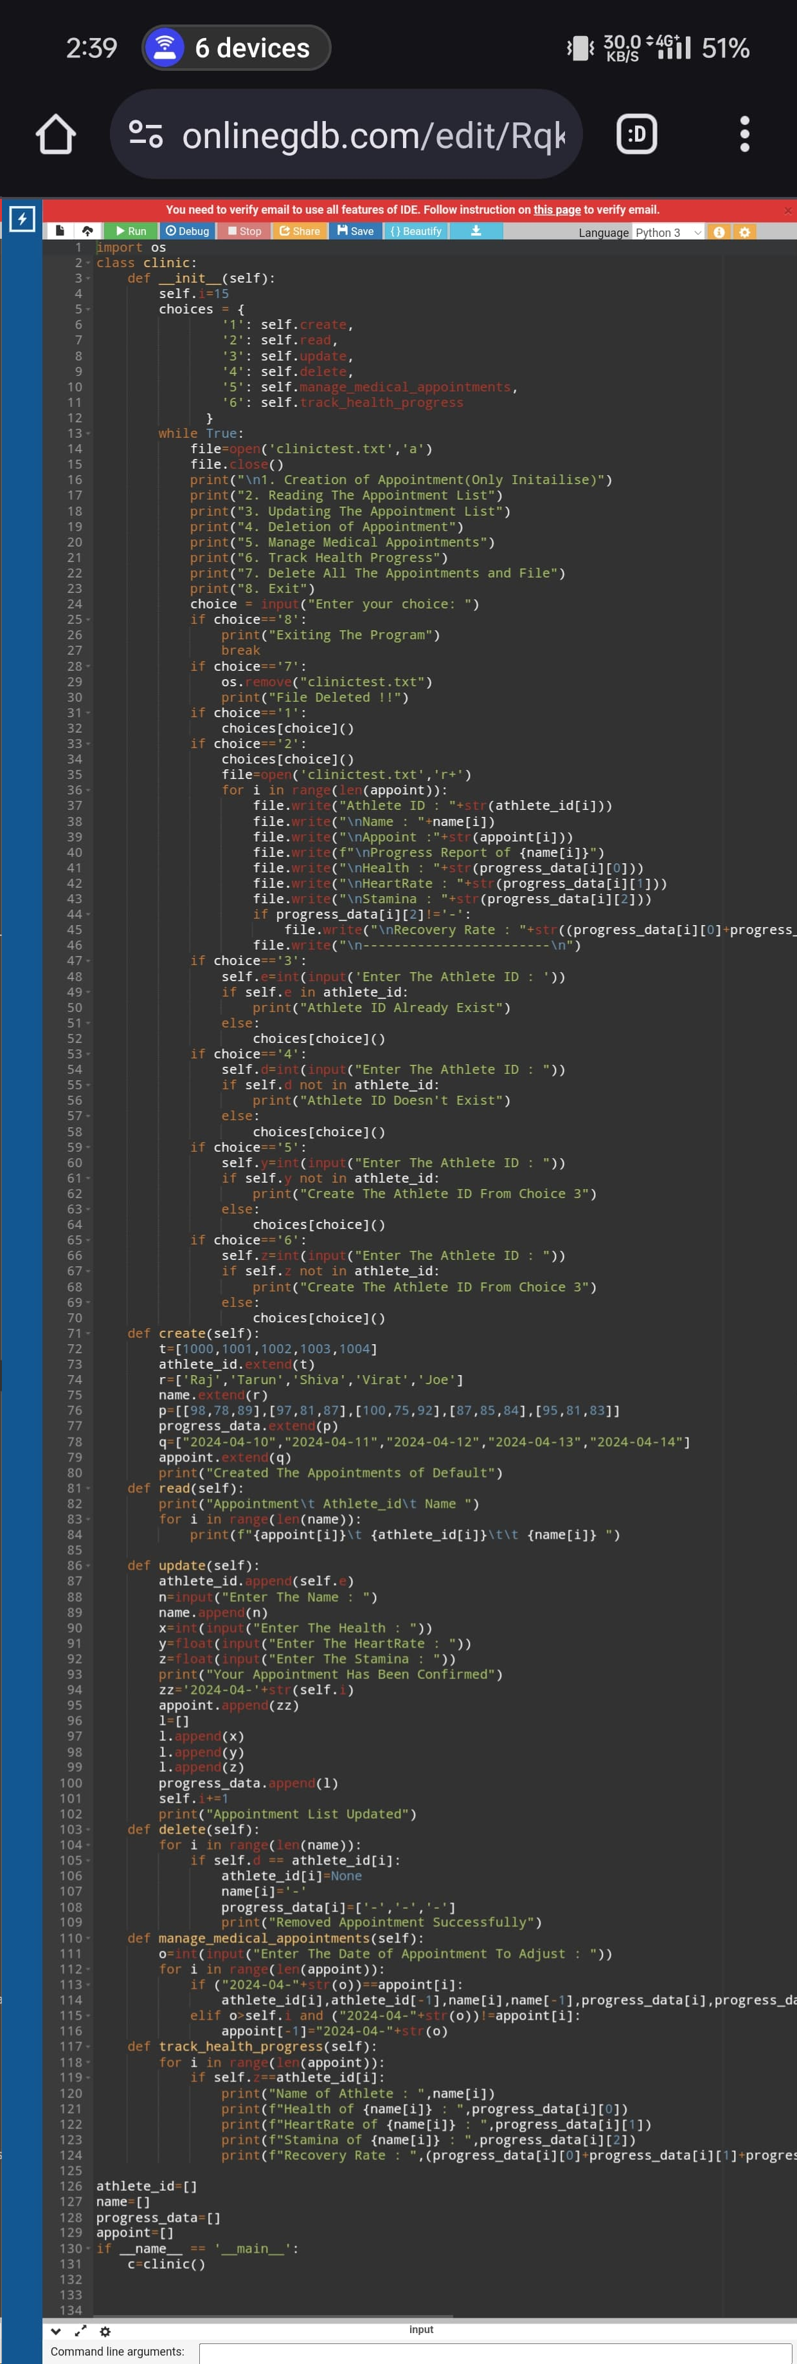

Slide 13
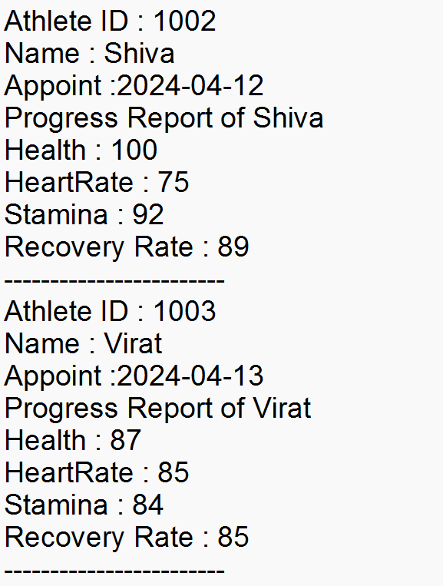
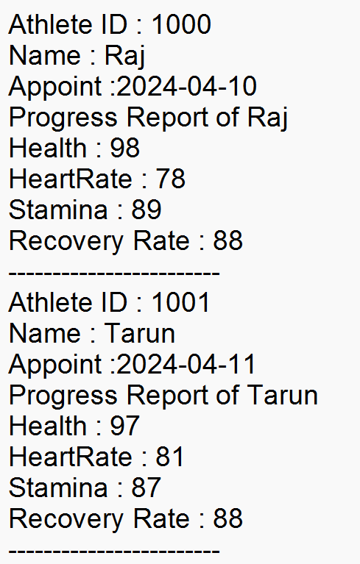
Result : Output

Slide 14
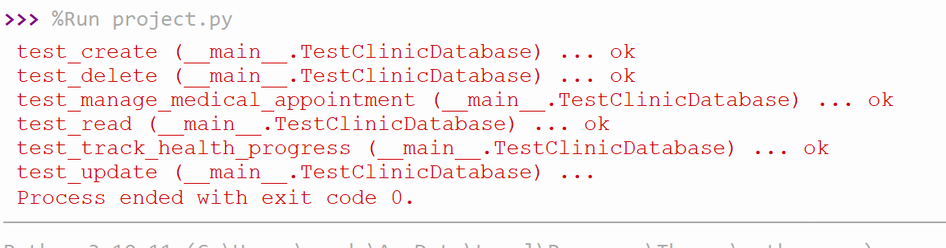

Slide 15
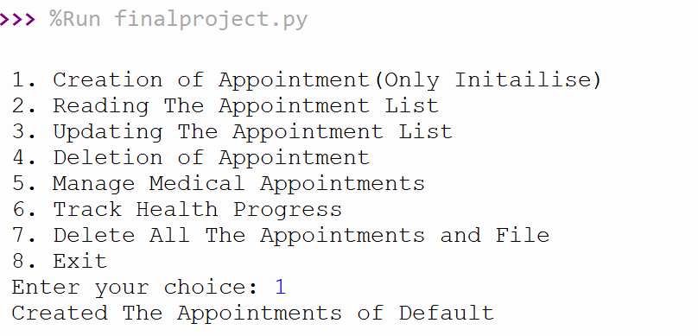
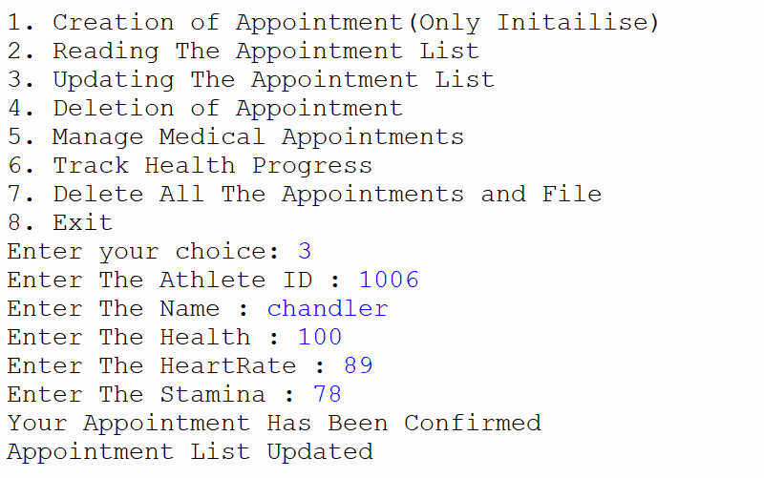
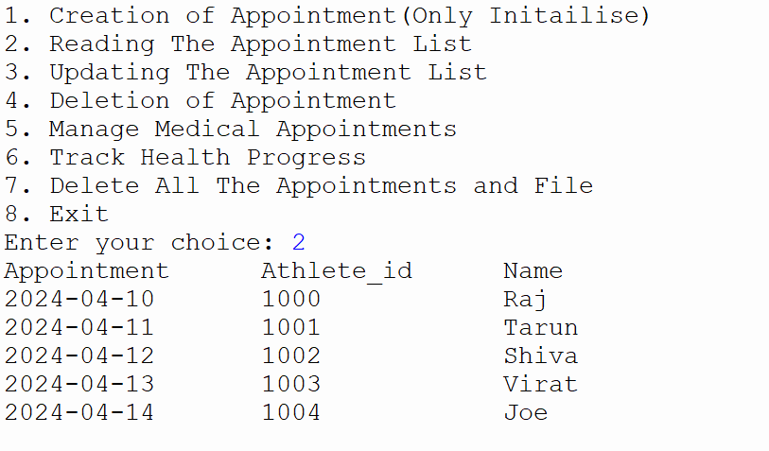
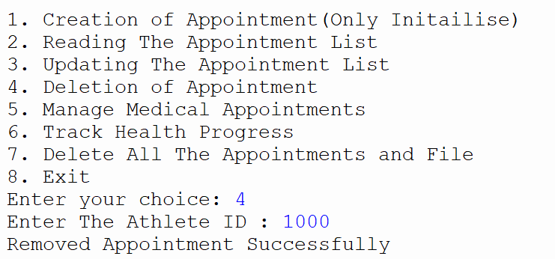

Slide 16
